Slide 1
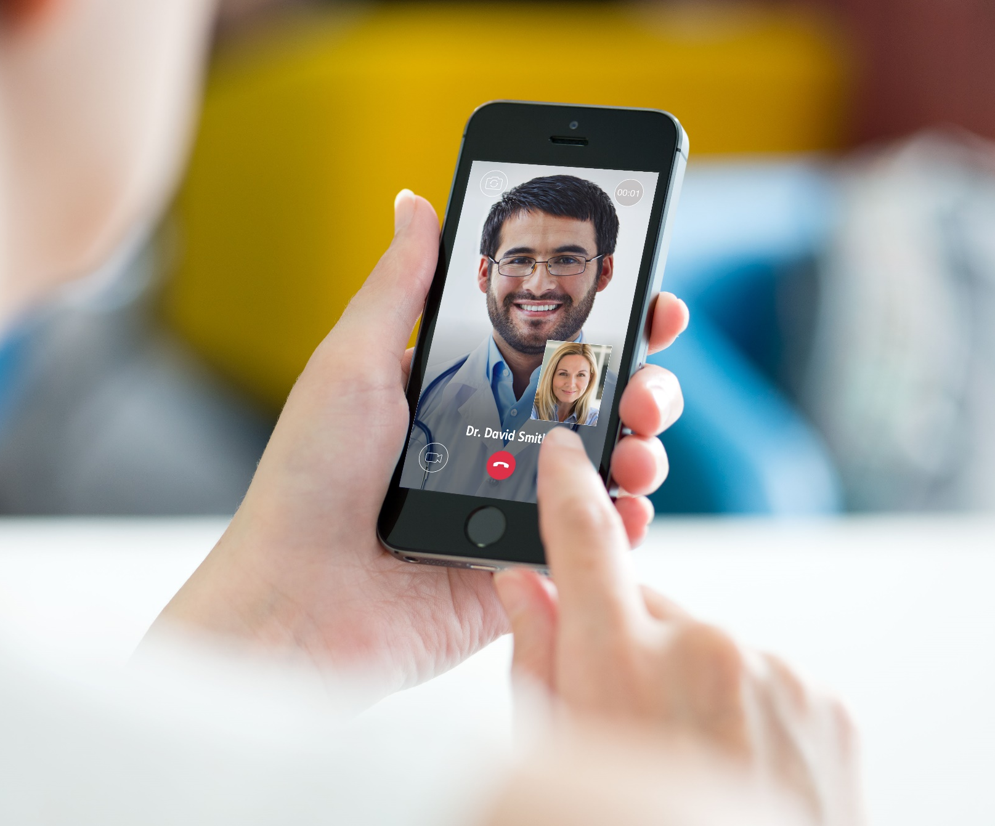
FEEL BETTER TODAY
HEALTH AT HAND

Slide 2



HEALTH AT HAND DOCTORS
Our doctors are supported and monitored by rigorous internal Quality Assurance and Quality Improvement standards
Our doctors are DHA licensed and have completed a comprehensive accreditation process including training in video consultation
Dr. Rami Said
Dr. Yousra Ali
General Practitioner
General Practitioner
Our doctors are all Family Medical Consultants or General Practitioners and are amongst the highest qualified in the country
All our doctors have extensive experience in telehealth
Dr. Zaib Shaikh
Dr. Esther Dairo
General Practitioner
General Practitioner
Notes:
Insert Dr.s photos with titles etc.

Slide 3
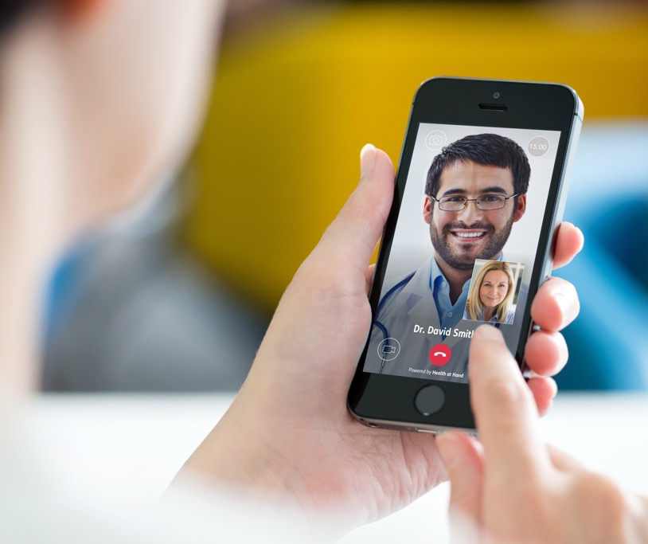
About health at hand
Founded in 2016, Health at Hand is the first telehealth platform to be fully licensed by the Dubai Health Authority.
  Using Health at Hand, patients can see a highly qualified doctor via video consultation whilst at home, in the office or when they’re travelling.
  Player independent from any Healthcare facility, ensuring ethical care with doctors located in Dubai, UAE.
  The only telehealth company to integrate medicine delivery into their app.
Notes:
Key points:
First telehealth provider fully licensed by the DHA in the MENA region
We are totally independent from any medical facilities and focus on ethical care – no commissions for us doctors hence no unnecessary tests and medicine prescriptions which is actually one of the core components of what we are about
With our app, you will have access to any of our highly qualified doctors through a video consultation on the app
Medicine delivery

Slide 4
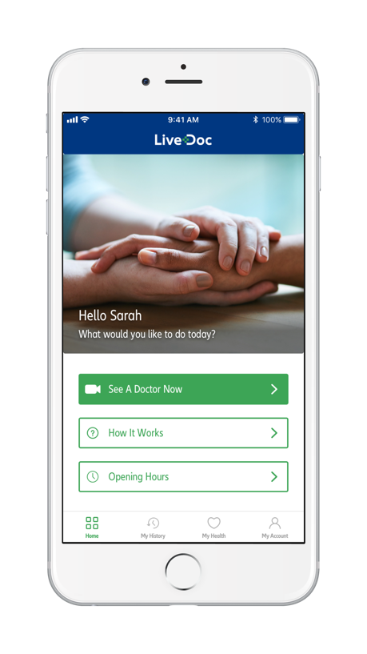
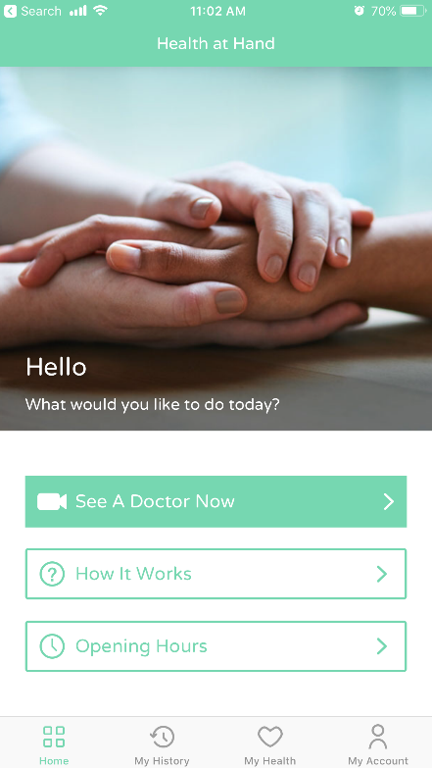
HEALTH AT HAND - a new patient experience
  Mobile app offering on-demand video consultations, connecting patients with doctors within minutes, making it the most convenient way to see a highly qualified doctor.
Available on Android and iOS
SIMPLE, FAST AND CONVENIENT
    Video consultations, 7 days a week - 6am-10pm (GST)*
    e-Prescription for OTC medicine** and lab tests
    Full access to personalized Doctor’s Reports, allowing you to manage past consultation reports and your medical reports.
    Medicine delivery (only in Dubai)
    English, Urdu, Hindi and Arabic speaking doctors
    For members: fully covered for all type of plans without co-pay.
    *Shorter hours on Fridays: 9am-6pm (GST). ** Prescription acceptance outside the U.A.E subject to local regulations
Notes:
What does a consultation entail? See a doctor, discuss your symptoms, get advice, and sometimes medications.
We take it further, we can have your medicines delivered to your doorstep within dubai, we also provide you with a detailed medical report and all these services are fully covered for you without any copays
Focus: opening times, multiple languages, medication delivery, no copays.

Slide 5
When a patient should use HEALTH AT HAND
Health at Hand doctors can give you medical advice, recommend treatments for non-emergency medical conditions such as:
Cough
Urinary symptoms
Cold
Eye infection
Sore throat
Indigestion
Earache
Diarrhoea
Headache
Sinus congestion
allergies
Rashes
These symptoms account for over 80% of all visits to an outpatient clinic
Notes:
Examples:
Advice

Slide 6


Why use HEALTH AT HAND?
When you’re feeling sick, which one would you use?
OR
Health at Hand
Doctor’s Clinic
See a doctor from the comfort of your own home
Save time, quick and convenient
Can be used anywhere in the world with internet connection
High quality service
Your prescription delivered to your doorstep
Find a clinic, call to check for doctor availability and possibly get an appointment
Leave the house, get stuck in traffic and sit in the waiting room
Stuck in a foreign country and making international calls to your insurer to see who will cover you
Find closest pharmacy to get your prescription, which is sometimes out of stock
Notes:
A scenario: you’re at work, begin to feel sick, and you think you might need a doctor’s attention… what do you do? Take some time off, call the clinic for an appt or do a walk in, traffic, wait at the clinic, etc
Talk about my nieces and nephews… advice, second opinions, etc
You never have to self medicate again – what you think might be a simple headache might not be.. Let us help you through all of your symptoms no matter how small or insignificant it may appear..

Slide 7
Download now
Have you downloaded Health at Hand app?
Download Now
Notes:
How do you begin to enjoy the benefits of an easy and stress-free consultation with a doctor?

Slide 8

7 SIMPLE STEPS
4
7 SIMPLE STEPS TO
3
5
2
6
#feelbettertoday
1
7
Notes:
Download the Health at Hand app from Apple iTunes or Google Play Store
Once launched, click on Login on the sign-up screen and enter your policy number to be able to access registration page and create your login details
To make a test video consultation, simply follow the following steps:
Click See A Doctor Now on the app Home screen
Select patient type Me and press NEXT
Enter any symptoms related text and/or upload photo for diagnosis and press NEXT/SKIP
Click on Pay as you go
Wait for a few seconds on ‘Checking connection’ screen. Press NEXT when the button turns green
Select the consent form (a tick box)
Tap on the Confirm button when its green
To see the Doctor’s Report click on the My History tab on the screen to view the report
Download the Health at Hand app from Apple iTunes or Google Play Store
2 Once launched, click on Login on the sign-up screen and enter the following login details
Email: NEXtCARE@hah.com
Password: NEXtCARE@hah
3 To make a test video consultation, simply follow the following steps:
• Tap See A Doctor Now on the app Home screen
• Select patient type Me and press NEXT
• Enter any symptoms related text and/or upload photo for diagnosis and press NEXT/SKIP
• Tap Pay as you go
• Wait for a few seconds on ‘Checking connection’ screen. Press NEXT when the button turns green
• Select the consent form (a tick box)
• Tap on the Confirm button when its green
4 To see the Doctor’s Report tap on the My History tab on the screen to view the report

Slide 9
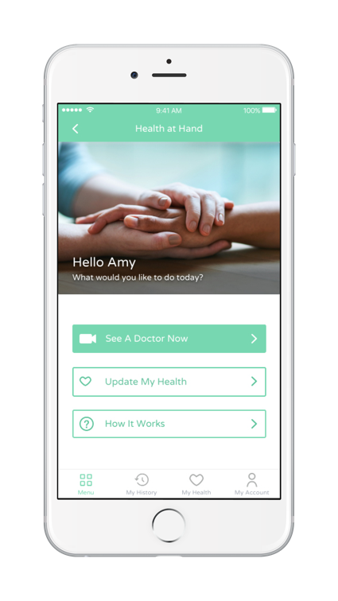
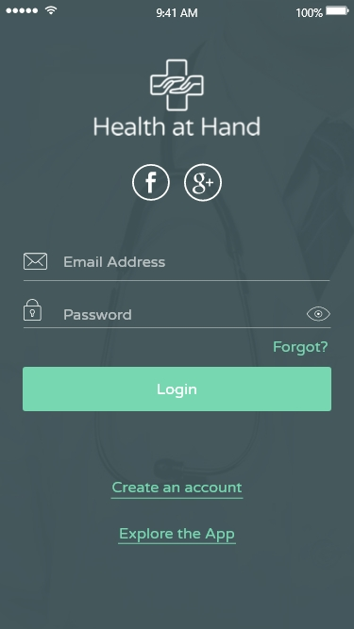

REGISTER
1
Register by entering policy/ID number and create account
Notes:
Recommend they use their personal email addresses – blocked work email addresses
Download the Health at Hand app from Apple iTunes or Google Play Store
Once launched, click on Login on the sign-up screen and enter your policy number to be able to access registration page and create your login details
To make a test video consultation, simply follow the following steps:
Click See A Doctor Now on the app Home screen
Select patient type Me and press NEXT
Enter any symptoms related text and/or upload photo for diagnosis and press NEXT/SKIP
Click on Pay as you go
Wait for a few seconds on ‘Checking connection’ screen. Press NEXT when the button turns green
Select the consent form (a tick box)
Tap on the Confirm button when its green
To see the Doctor’s Report click on the My History tab on the screen to view the report
Download the Health at Hand app from Apple iTunes or Google Play Store
2 Once launched, click on Login on the sign-up screen and enter the following login details
Email: NEXtCARE@hah.com
Password: NEXtCARE@hah
3 To make a test video consultation, simply follow the following steps:
• Tap See A Doctor Now on the app Home screen
• Select patient type Me and press NEXT
• Enter any symptoms related text and/or upload photo for diagnosis and press NEXT/SKIP
• Tap Pay as you go
• Wait for a few seconds on ‘Checking connection’ screen. Press NEXT when the button turns green
• Select the consent form (a tick box)
• Tap on the Confirm button when its green
4 To see the Doctor’s Report tap on the My History tab on the screen to view the report

Slide 10
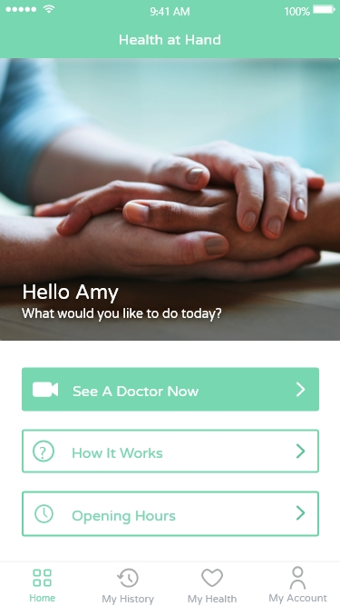

CALLING A DOCTOR
2
Select “See a doctor now”
Notes:
Download the Health at Hand app from Apple iTunes or Google Play Store
Once launched, click on Login on the sign-up screen and enter your policy number to be able to access registration page and create your login details
To make a test video consultation, simply follow the following steps:
Click See A Doctor Now on the app Home screen
Select patient type Me and press NEXT
Enter any symptoms related text and/or upload photo for diagnosis and press NEXT/SKIP
Click on Pay as you go
Wait for a few seconds on ‘Checking connection’ screen. Press NEXT when the button turns green
Select the consent form (a tick box)
Tap on the Confirm button when its green
To see the Doctor’s Report click on the My History tab on the screen to view the report
Download the Health at Hand app from Apple iTunes or Google Play Store
2 Once launched, click on Login on the sign-up screen and enter the following login details
Email: NEXtCARE@hah.com
Password: NEXtCARE@hah
3 To make a test video consultation, simply follow the following steps:
• Tap See A Doctor Now on the app Home screen
• Select patient type Me and press NEXT
• Enter any symptoms related text and/or upload photo for diagnosis and press NEXT/SKIP
• Tap Pay as you go
• Wait for a few seconds on ‘Checking connection’ screen. Press NEXT when the button turns green
• Select the consent form (a tick box)
• Tap on the Confirm button when its green
4 To see the Doctor’s Report tap on the My History tab on the screen to view the report

Slide 11

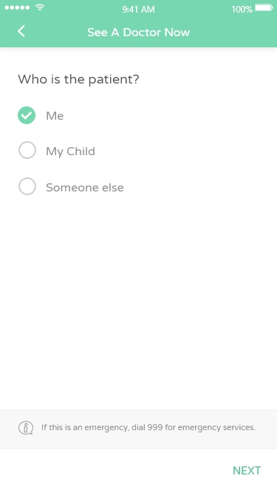
SELECTING THE PATIENT
3
Select patient or beneficiary
Notes:
Download the Health at Hand app from Apple iTunes or Google Play Store
Once launched, click on Login on the sign-up screen and enter your policy number to be able to access registration page and create your login details
To make a test video consultation, simply follow the following steps:
Click See A Doctor Now on the app Home screen
Select patient type Me and press NEXT
Enter any symptoms related text and/or upload photo for diagnosis and press NEXT/SKIP
Click on Pay as you go
Wait for a few seconds on ‘Checking connection’ screen. Press NEXT when the button turns green
Select the consent form (a tick box)
Tap on the Confirm button when its green
To see the Doctor’s Report click on the My History tab on the screen to view the report
Download the Health at Hand app from Apple iTunes or Google Play Store
2 Once launched, click on Login on the sign-up screen and enter the following login details
Email: NEXtCARE@hah.com
Password: NEXtCARE@hah
3 To make a test video consultation, simply follow the following steps:
• Tap See A Doctor Now on the app Home screen
• Select patient type Me and press NEXT
• Enter any symptoms related text and/or upload photo for diagnosis and press NEXT/SKIP
• Tap Pay as you go
• Wait for a few seconds on ‘Checking connection’ screen. Press NEXT when the button turns green
• Select the consent form (a tick box)
• Tap on the Confirm button when its green
4 To see the Doctor’s Report tap on the My History tab on the screen to view the report

Slide 12
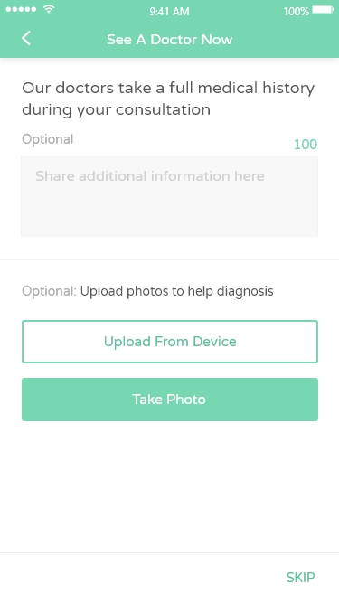

BRIEFING THE DOCTOR
4
Fill out basic symptoms and select a photo of a skin and/or an eye condition to upload
Notes:
Download the Health at Hand app from Apple iTunes or Google Play Store
Once launched, click on Login on the sign-up screen and enter your policy number to be able to access registration page and create your login details
To make a test video consultation, simply follow the following steps:
Click See A Doctor Now on the app Home screen
Select patient type Me and press NEXT
Enter any symptoms related text and/or upload photo for diagnosis and press NEXT/SKIP
Click on Pay as you go
Wait for a few seconds on ‘Checking connection’ screen. Press NEXT when the button turns green
Select the consent form (a tick box)
Tap on the Confirm button when its green
To see the Doctor’s Report click on the My History tab on the screen to view the report
Download the Health at Hand app from Apple iTunes or Google Play Store
2 Once launched, click on Login on the sign-up screen and enter the following login details
Email: NEXtCARE@hah.com
Password: NEXtCARE@hah
3 To make a test video consultation, simply follow the following steps:
• Tap See A Doctor Now on the app Home screen
• Select patient type Me and press NEXT
• Enter any symptoms related text and/or upload photo for diagnosis and press NEXT/SKIP
• Tap Pay as you go
• Wait for a few seconds on ‘Checking connection’ screen. Press NEXT when the button turns green
• Select the consent form (a tick box)
• Tap on the Confirm button when its green
4 To see the Doctor’s Report tap on the My History tab on the screen to view the report

Slide 13
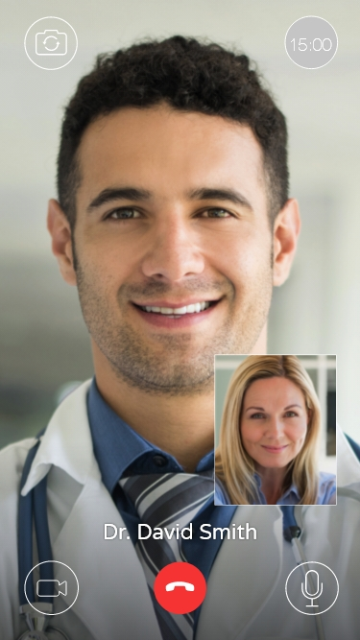
SEEING THE DOCTOR
5
Video consultation begins
Notes:
Download the Health at Hand app from Apple iTunes or Google Play Store
Once launched, click on Login on the sign-up screen and enter your policy number to be able to access registration page and create your login details
To make a test video consultation, simply follow the following steps:
Click See A Doctor Now on the app Home screen
Select patient type Me and press NEXT
Enter any symptoms related text and/or upload photo for diagnosis and press NEXT/SKIP
Click on Pay as you go
Wait for a few seconds on ‘Checking connection’ screen. Press NEXT when the button turns green
Select the consent form (a tick box)
Tap on the Confirm button when its green
To see the Doctor’s Report click on the My History tab on the screen to view the report
Download the Health at Hand app from Apple iTunes or Google Play Store
2 Once launched, click on Login on the sign-up screen and enter the following login details
Email: NEXtCARE@hah.com
Password: NEXtCARE@hah
3 To make a test video consultation, simply follow the following steps:
• Tap See A Doctor Now on the app Home screen
• Select patient type Me and press NEXT
• Enter any symptoms related text and/or upload photo for diagnosis and press NEXT/SKIP
• Tap Pay as you go
• Wait for a few seconds on ‘Checking connection’ screen. Press NEXT when the button turns green
• Select the consent form (a tick box)
• Tap on the Confirm button when its green
4 To see the Doctor’s Report tap on the My History tab on the screen to view the report

Slide 14
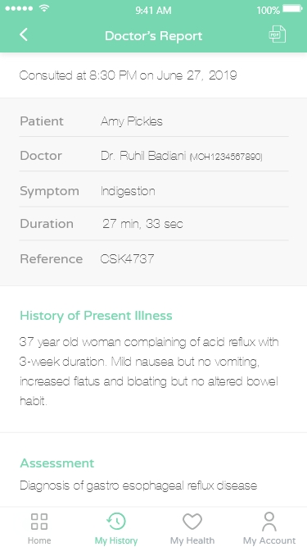

AFTER THE CALL
6
After ending the call, patient will receive a medical report with advice and recommended (deliverable) medication
Notes:
Download the Health at Hand app from Apple iTunes or Google Play Store
Once launched, click on Login on the sign-up screen and enter your policy number to be able to access registration page and create your login details
To make a test video consultation, simply follow the following steps:
Click See A Doctor Now on the app Home screen
Select patient type Me and press NEXT
Enter any symptoms related text and/or upload photo for diagnosis and press NEXT/SKIP
Click on Pay as you go
Wait for a few seconds on ‘Checking connection’ screen. Press NEXT when the button turns green
Select the consent form (a tick box)
Tap on the Confirm button when its green
To see the Doctor’s Report click on the My History tab on the screen to view the report
Download the Health at Hand app from Apple iTunes or Google Play Store
2 Once launched, click on Login on the sign-up screen and enter the following login details
Email: NEXtCARE@hah.com
Password: NEXtCARE@hah
3 To make a test video consultation, simply follow the following steps:
• Tap See A Doctor Now on the app Home screen
• Select patient type Me and press NEXT
• Enter any symptoms related text and/or upload photo for diagnosis and press NEXT/SKIP
• Tap Pay as you go
• Wait for a few seconds on ‘Checking connection’ screen. Press NEXT when the button turns green
• Select the consent form (a tick box)
• Tap on the Confirm button when its green
4 To see the Doctor’s Report tap on the My History tab on the screen to view the report

Slide 15
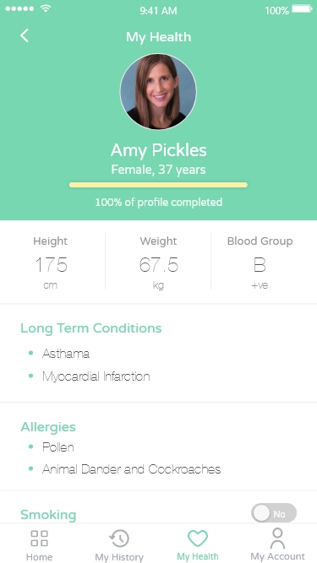


YOUR HEALTH
7
Patient can access their medical records anytime through the “My Health” section of the app
Notes:
Download the Health at Hand app from Apple iTunes or Google Play Store
Once launched, click on Login on the sign-up screen and enter your policy number to be able to access registration page and create your login details
To make a test video consultation, simply follow the following steps:
Click See A Doctor Now on the app Home screen
Select patient type Me and press NEXT
Enter any symptoms related text and/or upload photo for diagnosis and press NEXT/SKIP
Click on Pay as you go
Wait for a few seconds on ‘Checking connection’ screen. Press NEXT when the button turns green
Select the consent form (a tick box)
Tap on the Confirm button when its green
To see the Doctor’s Report click on the My History tab on the screen to view the report
Download the Health at Hand app from Apple iTunes or Google Play Store
2 Once launched, click on Login on the sign-up screen and enter the following login details
Email: NEXtCARE@hah.com
Password: NEXtCARE@hah
3 To make a test video consultation, simply follow the following steps:
• Tap See A Doctor Now on the app Home screen
• Select patient type Me and press NEXT
• Enter any symptoms related text and/or upload photo for diagnosis and press NEXT/SKIP
• Tap Pay as you go
• Wait for a few seconds on ‘Checking connection’ screen. Press NEXT when the button turns green
• Select the consent form (a tick box)
• Tap on the Confirm button when its green
4 To see the Doctor’s Report tap on the My History tab on the screen to view the report

Slide 16
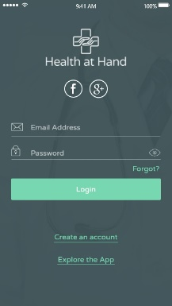
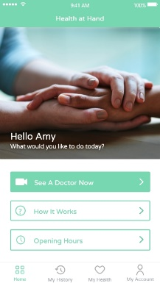
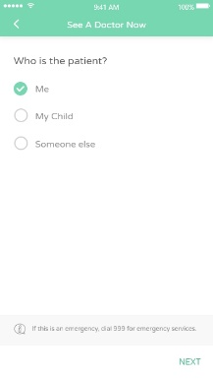
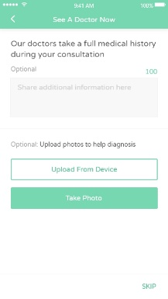

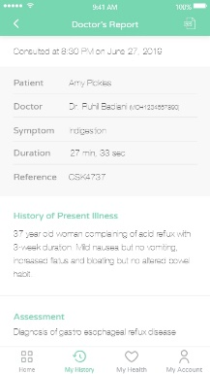
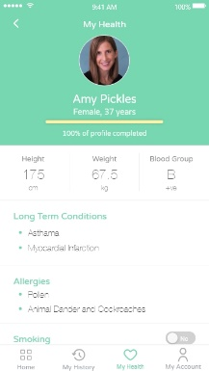

Customer journey
Login
Home
Select Patient
Photo Upload
Call
Doctor’s Report
MyHealth
Fills out basic symptom description and uploads photo (optional)
After the call, patient receives his medical report with doctor’s advice and OTC prescription
Patient registers by entering policy/ID number and creates account
Clicks on
“See a doctor now”
Video consultation begins
Patient
downloads app
Selects the beneficiary
Doctor can arrange for drug delivery to the patient’s address
HAH Insurance User
HAH Promo code user
Notes:
Overview of how to use the app
Conduct the live demo here NEED TO COMPLETE PROTOTYPE

Slide 17

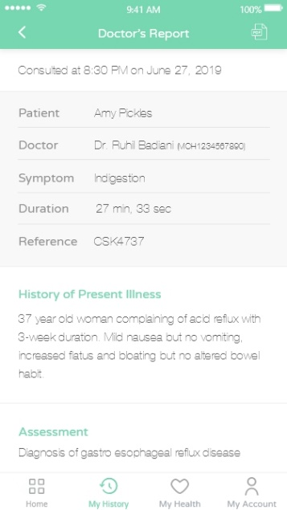

THANK YOU

